Slide 1


Slide 2
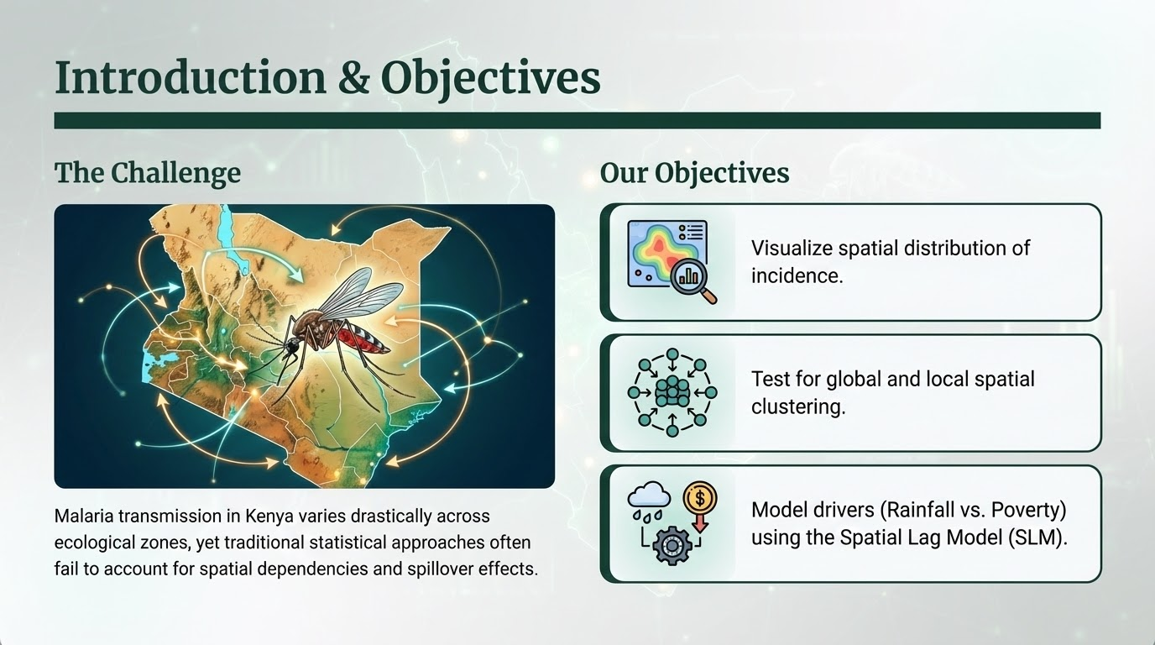

Slide 3
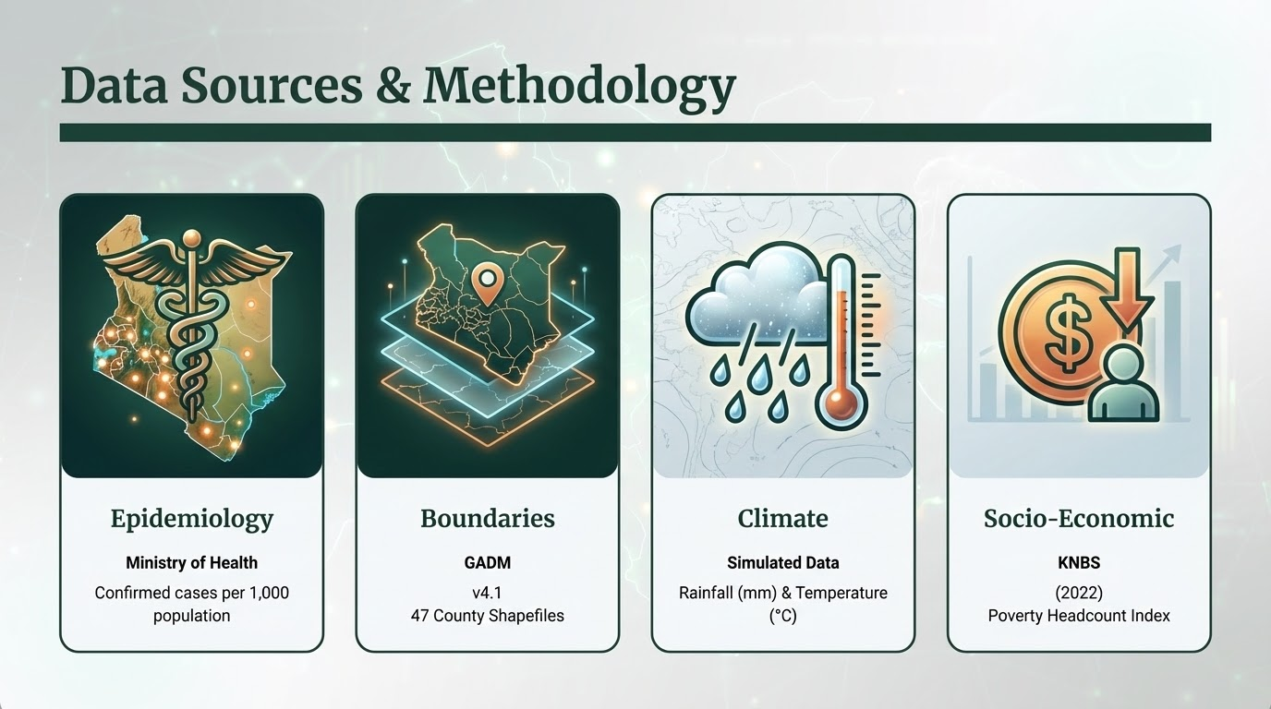

Slide 4
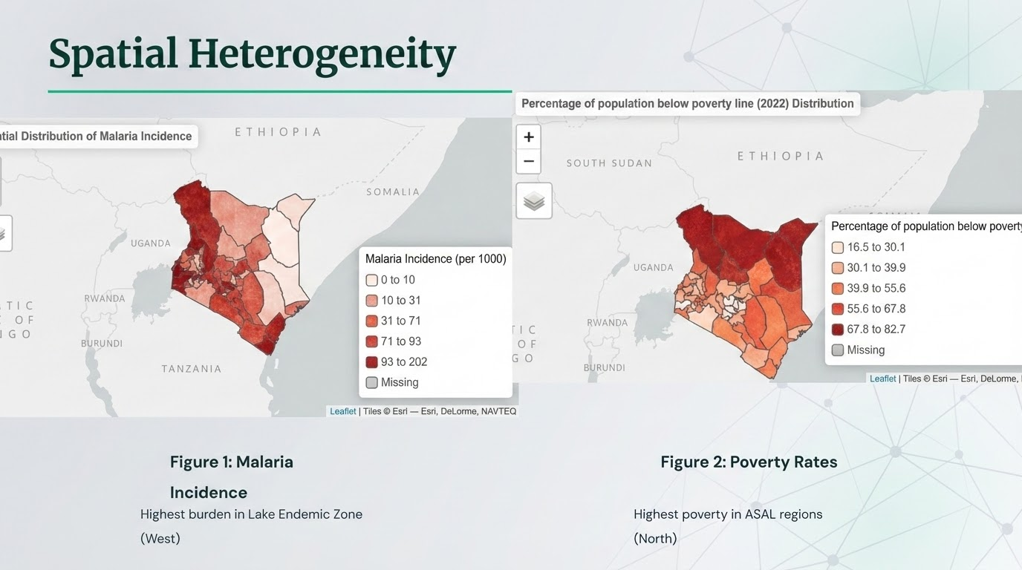

Slide 5
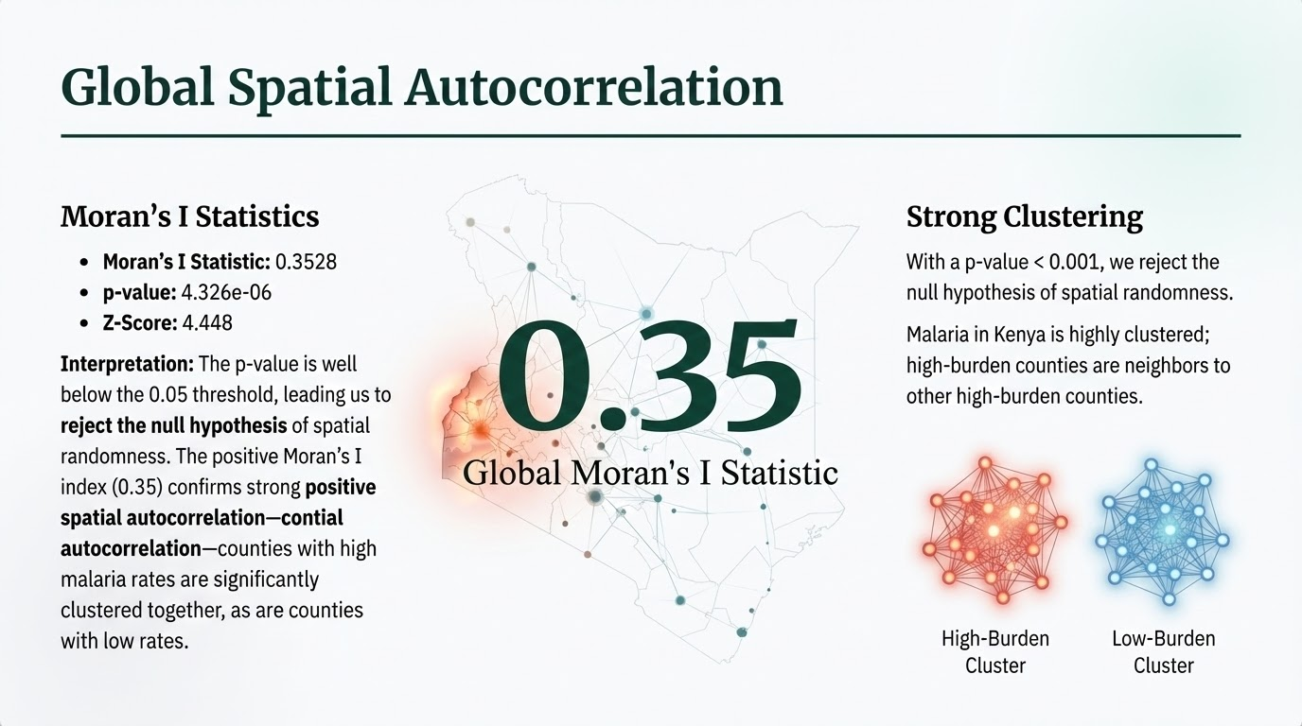

Slide 6
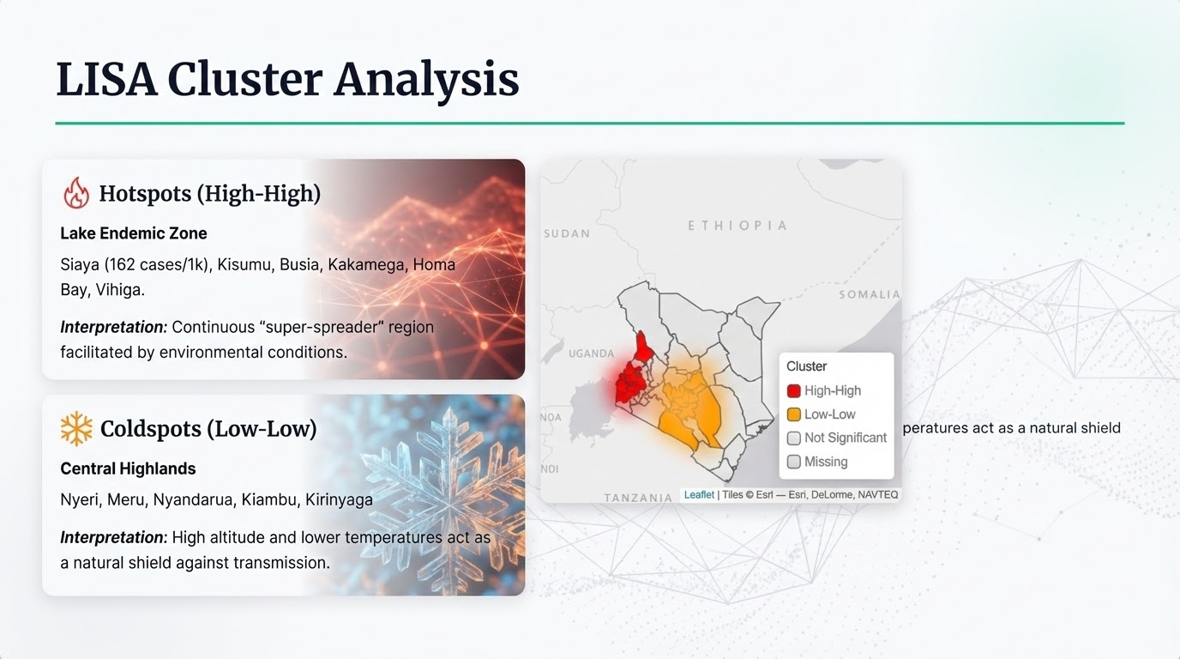

Slide 7
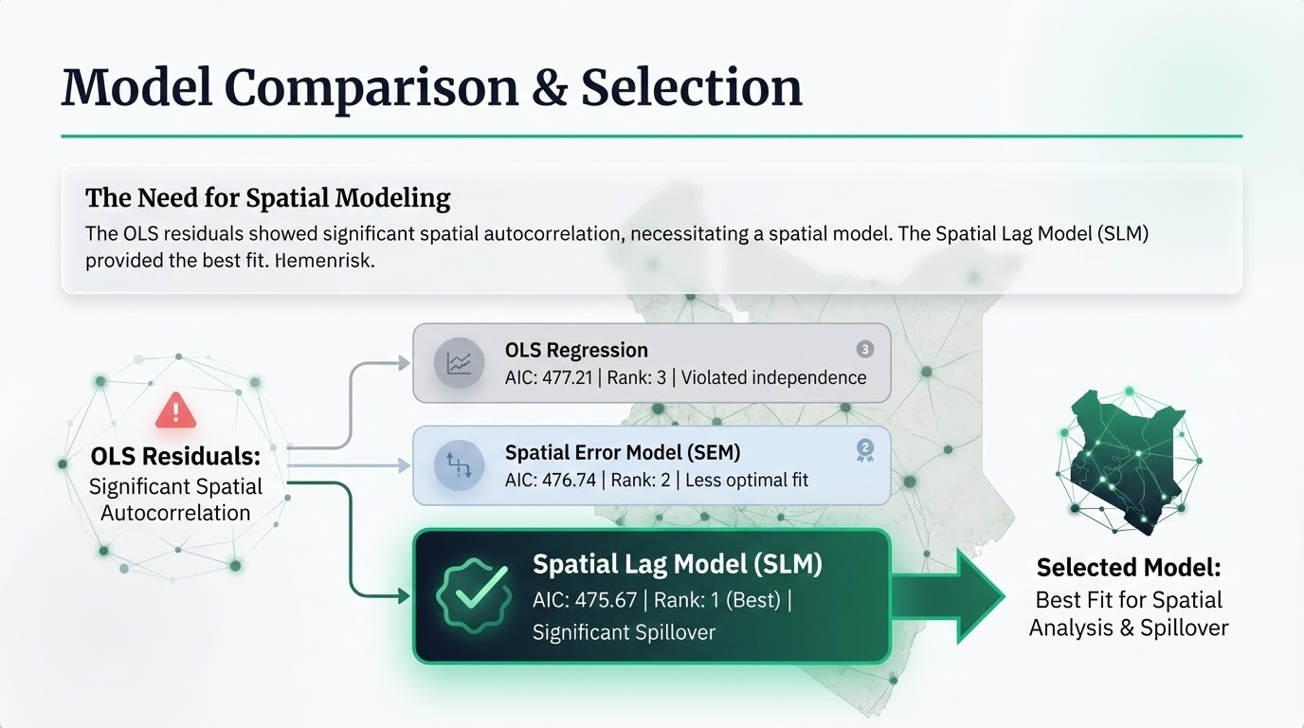

Slide 8

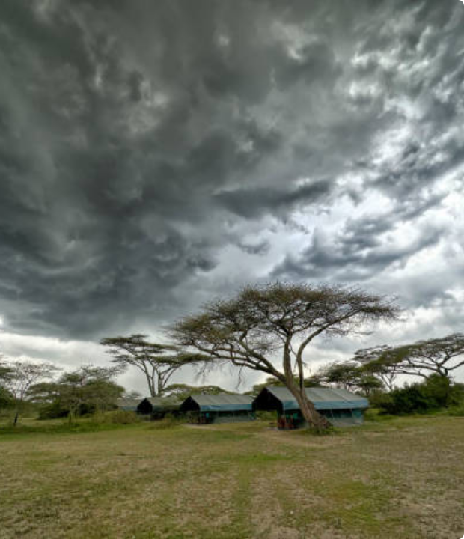

Spatial Lag Results
The Model Equation:
•
Rho (ρ) = 0.37: Significant spillover. 37% of infection risk is influenced by neighboring counties.
•
Rainfall (p=0.006): The primary environmental driver.
•
Poverty: Not statistically significant when accounting for spatial lag.

Slide 9
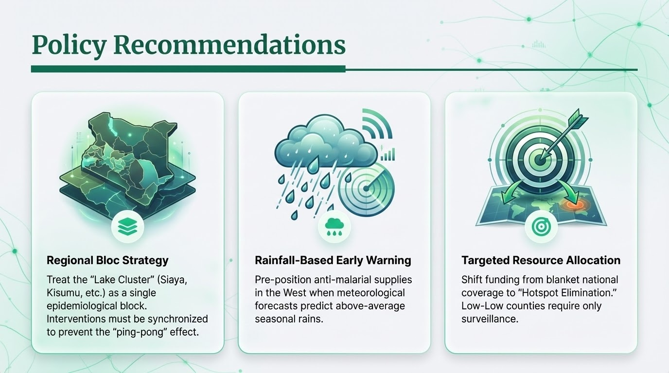

Slide 10


Slide 11





Image Sources
https://images.picxy.com/cache/2020/9/18/4208ece99b0a787cec85a1ab106056f0.jpg
Source: www.picxy.com
https://upload.wikimedia.org/wikipedia/commons/4/4e/Map_showing_counties_under_the_new_Kenyan_constitution.gif
Source: en.wikipedia.org
https://static.vecteezy.com/system/resources/previews/070/721/925/non_2x/abstract-blue-network-visualization-futuristic-connection-with-data-points-and-nodes-for-technology-concepts-photo.jpeg
Source: www.vecteezy.com
https://media.istockphoto.com/id/1692452994/photo/view-of-camp-tents-in-thunderstorm-in-tanzania.jpg?s=612x612&w=0&k=20&c=n2ZViVJGymFPibskTa4qOo8DS3rkk5gOuTSl3i-9mHY=
Source: www.istockphoto.com

